Slide 1
.NET Aspire. Getting started
Lukas Durovsky
Staff software engineer
.NET DAY SWITZERLAND 2025

Slide 2
Me
Software Engineer
~10 years of experience, various projects, mostly life science
Conference speaker, Workshop developer

Slide 3
Introduction

Slide 4
Some of the challenges of cloud-native world
Grasping system architecture
What (micro)services the system is built of?
How to run them?
What backing services are there for each (micro)service?
How to run them?
Onboarding
Communication
Service discovery
Dependency management

Slide 5
Some of the challenges of cloud-native world
Resiliency
Temporal service downtime
Retries, Timeouts, Circuit Breaker
Development runtime – ‘development inner loop’
Running the application locally
Observing the behavior, Debugging, Performance analysis
Reading/editing *.yaml file

Slide 6
What .NET Aspire is?
Stack for building cloud-native applications in .NET
Dev-time orchestration tool
You just press F5 and in a while, everything is ready to be debugged

Slide 7
What problems does .NET Aspire solve?
“.NET Aspire's strength lies in its ability to provide an amazing developer inner-loop”
Local Development Orchestration and Setup Complexity
Debugging
Service Discovery & Connection Management
Arguments passing
Observability configuration
Telemetry, Tracing, Metrics, Health-checks
Boilerplate code
Resilience (Retries, Circuit Breakers…)
You do not need to solve provisioning of Azure resources

Slide 8
Pitfalls
All your (micro)services must be in same solution
You can partially solve this by ‘.AddDockerFile’, ‘.AddContainer’, ‘.AddExecutable’
Support and documentation
Emerging technology, lot of changes very often
https://learn.microsoft.com/en-us/dotnet/aspire/whats-new/dotnet-aspire-9.4
I see some similarities to GitHub Copilot
Major changes between versions
Articles on the Internet may be just a few weeks old, but they are for older version
🤖 GitHub Copilot support
Inappropriate completions
Getting some suggestion from .NET Aspire 9.2 SDK, but I am using 9.3

Slide 9
Relationship with well-known tools
Docker
Might be used for some components (Redis, PostgreSQL…) in your .NET Aspire App
Docker Compose
Declarative - Imperative
YAML - C#
Developers can use something they already know, no need to learn something new
Just Containers vs. Different kind of integrations
Kubernetes
Aspire can create manifest list that can be used for deployment to Kubernetes

Slide 10
Hello world!
Let’s see HOW IT WORKS

Slide 11
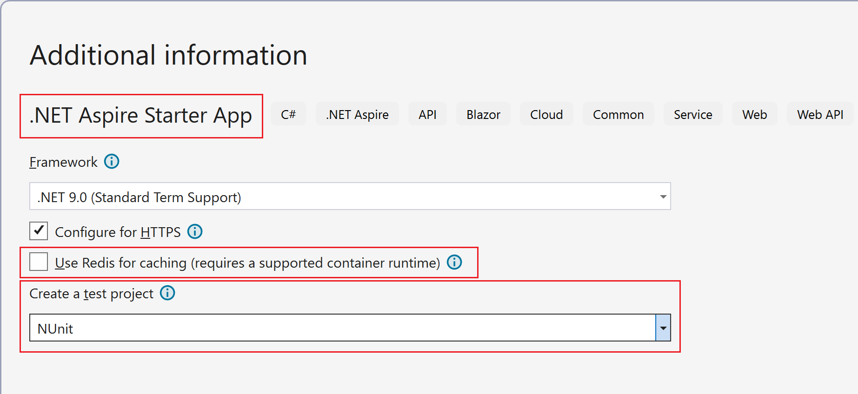

Slide 12
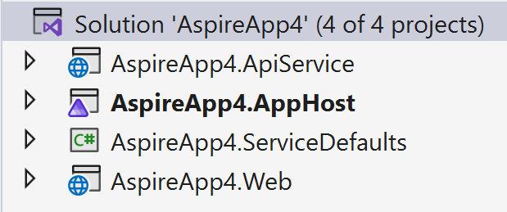

Slide 13
ServiceDefaults project
Cross-cutting concerns of cloud-native apps
Health checks
Telemetry
Service discovery
Resiliency
HttpClient configuration
Can be customized to fit specific needs

Slide 14
AppHost project
App model definition
Resources - references, relationships
Integrations
Orchestration
Delegated to Developer Control Plane (DCP) - Core of the project
Startup project

Slide 15
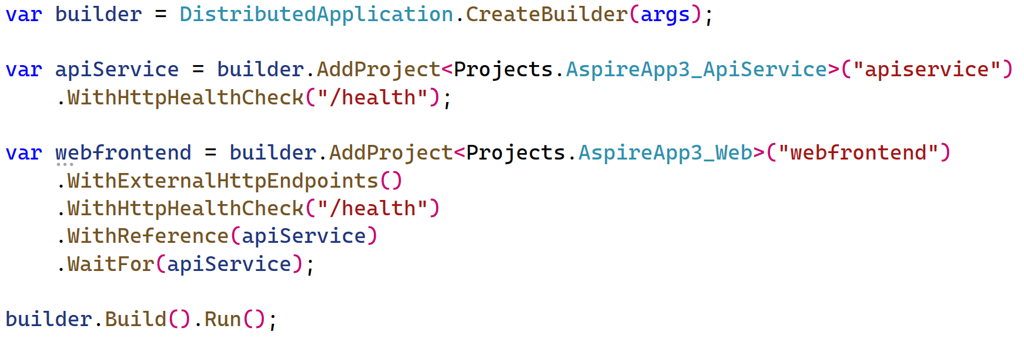
C# version of docker-compose.yaml 😇

Slide 16
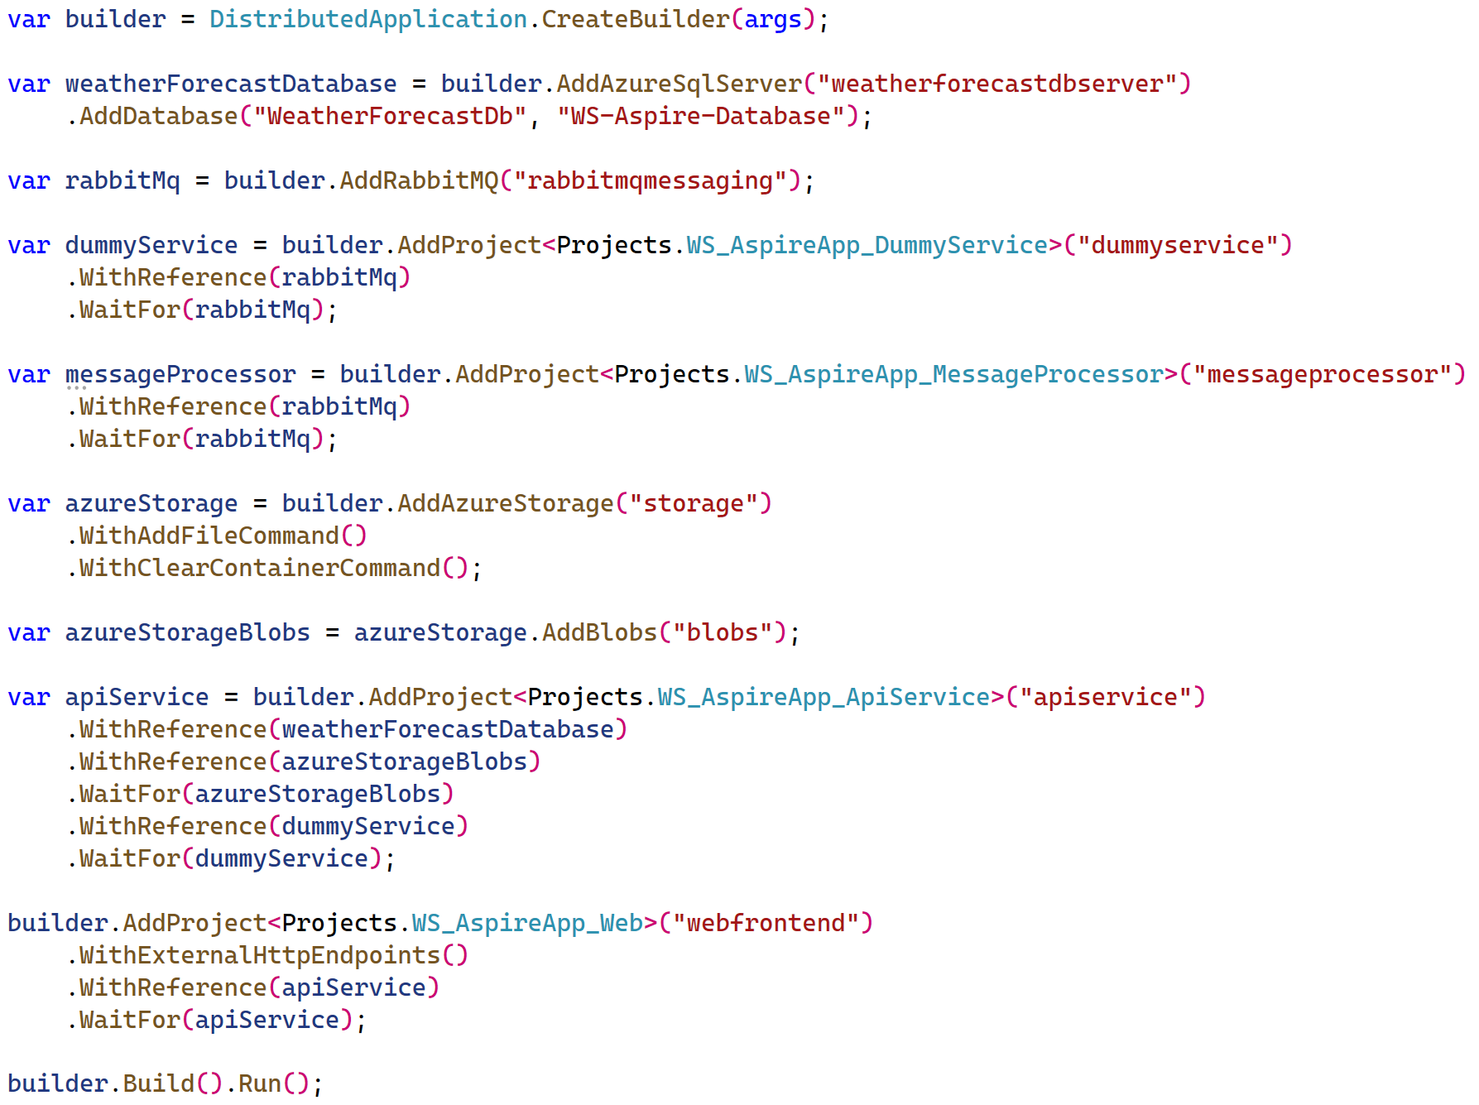

Slide 17
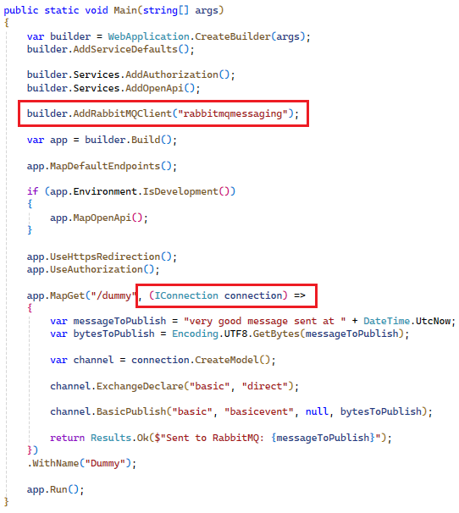

Slide 18
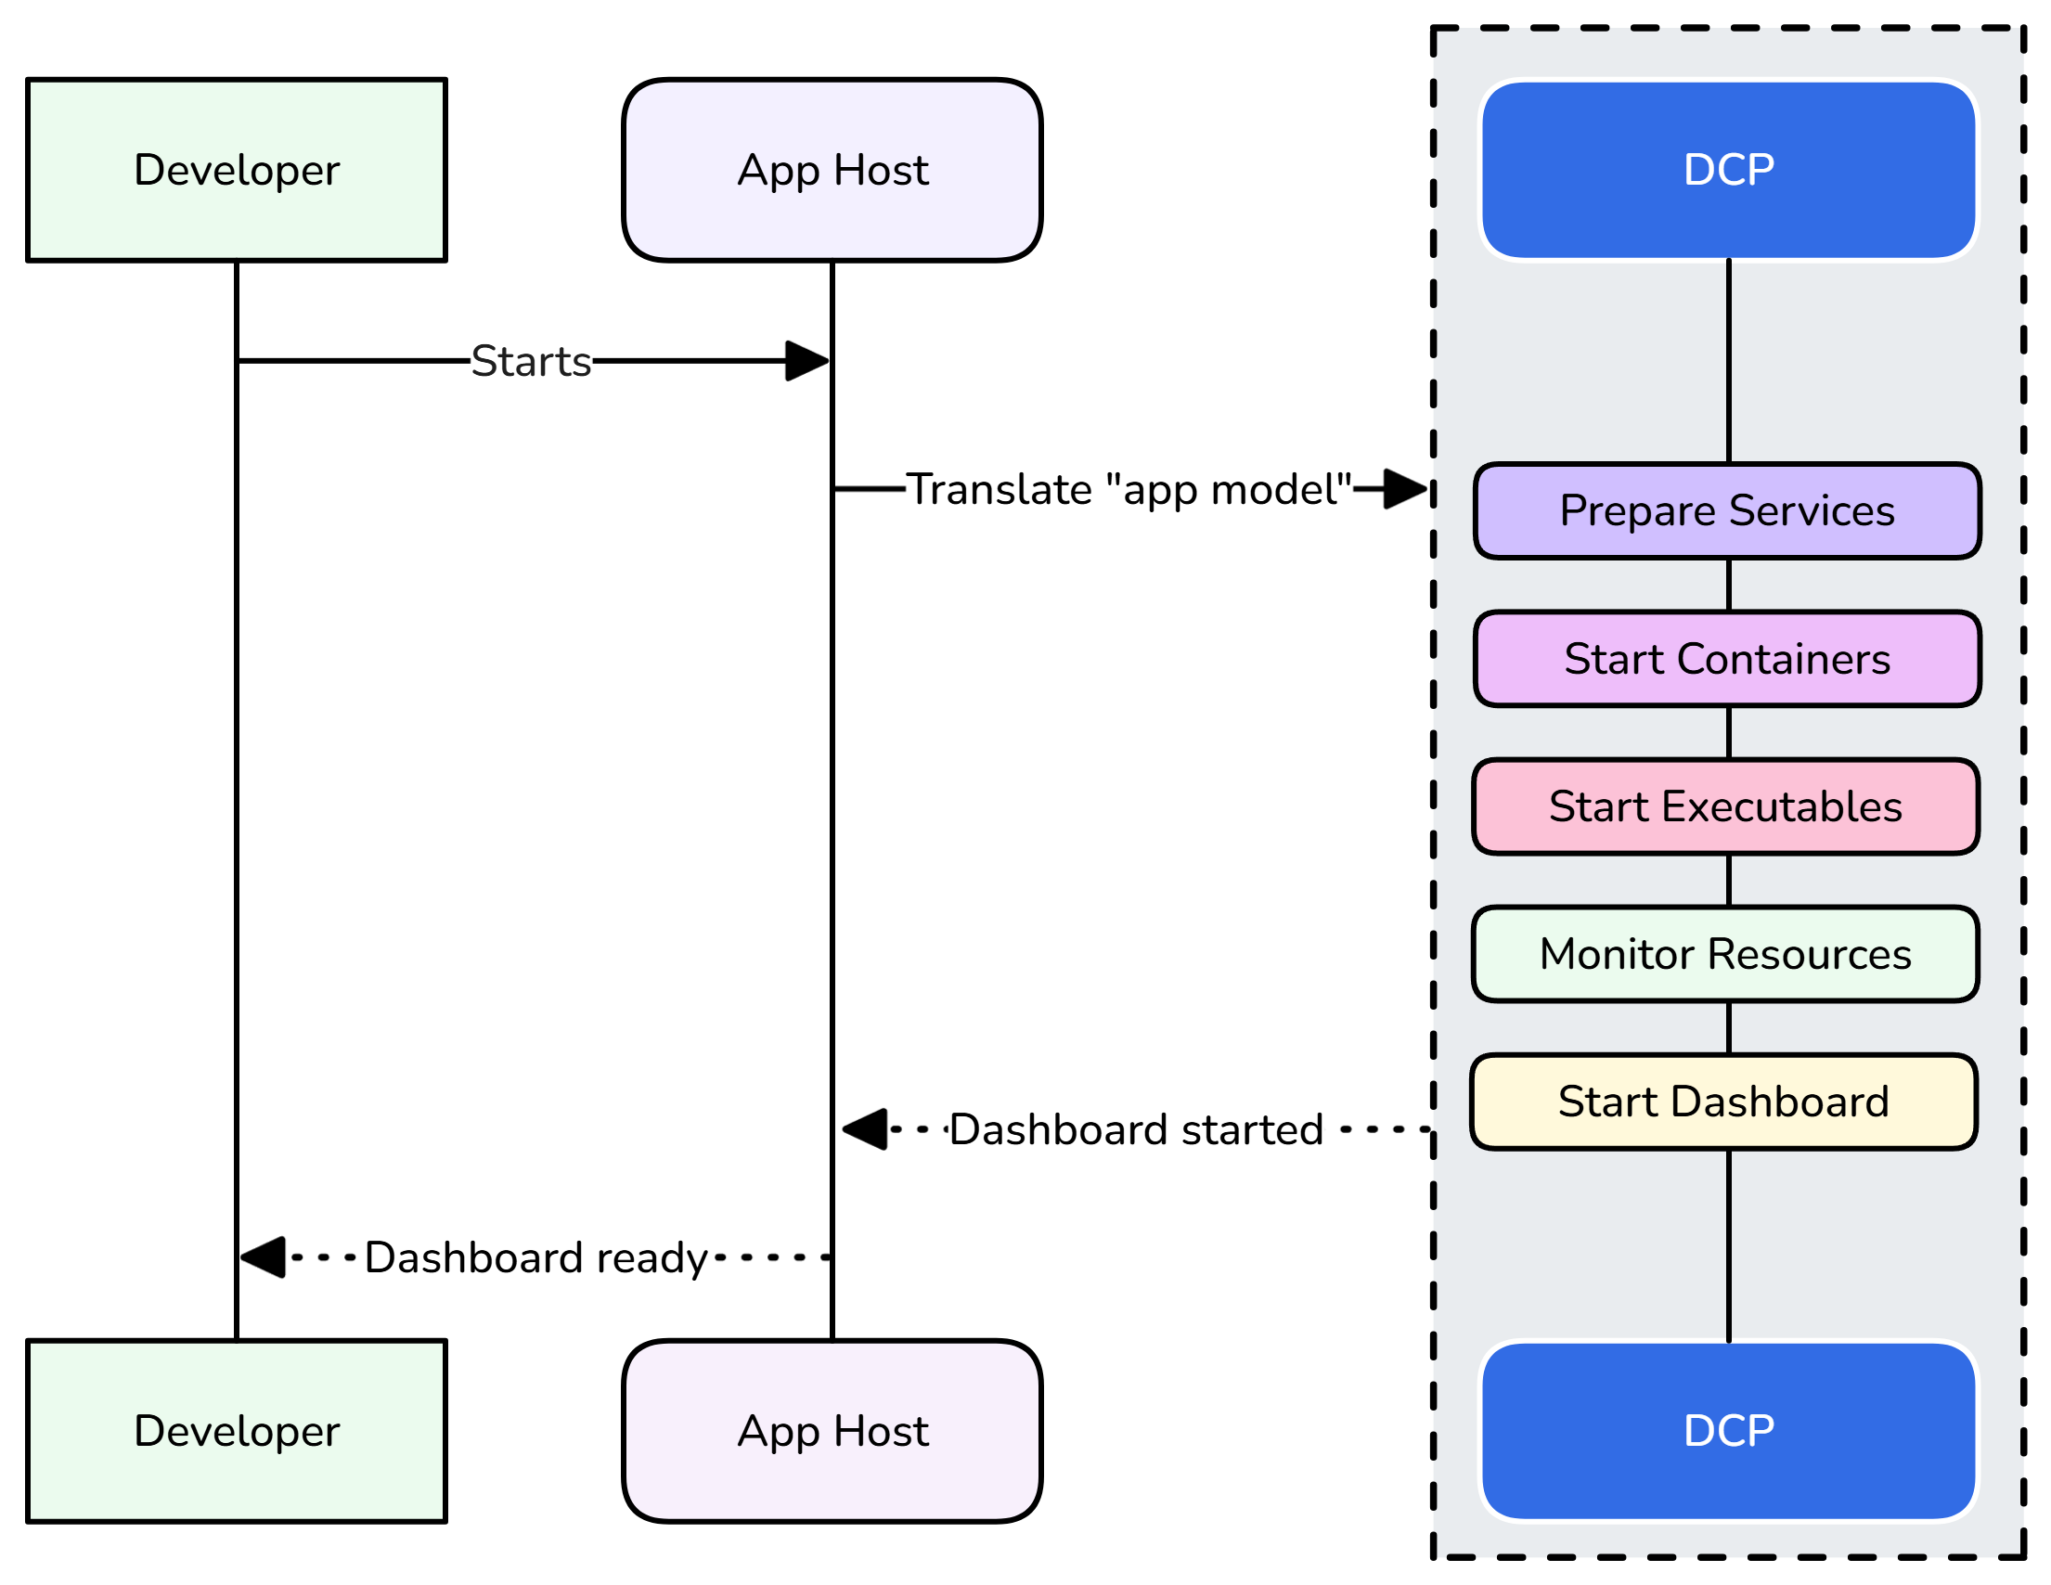

Slide 19
AppHost – synchronization
.WithExplicitStart()
.WaitFor(resource)
Enforce resource start - dashboard

Slide 20
AppHost – service discovery
.WithReference(…)
Environment variables, Naming conventions

Slide 21
What can you add to your app model?
.AddProject
.AddExecutable
.AddDockerFile
.AddParameter, .AddConnectionString
Add something, that is resolved as a container
.AddSqlServer, .AddRedis…
Add Azure resource
.AddAzureStorage, .AddAzureCosmosDB …

Slide 22
Integrations

Slide 23
Integrations
One of the core features of .NET Aspire
NuGet packages
Easily integrate common backing services to your app
RabbitMQ, Redis, SQL, Azure resources...
Two kinds of integrations
Hosting – used in AppHost project
Client – used in your services
Mostly used in pairs

Slide 24
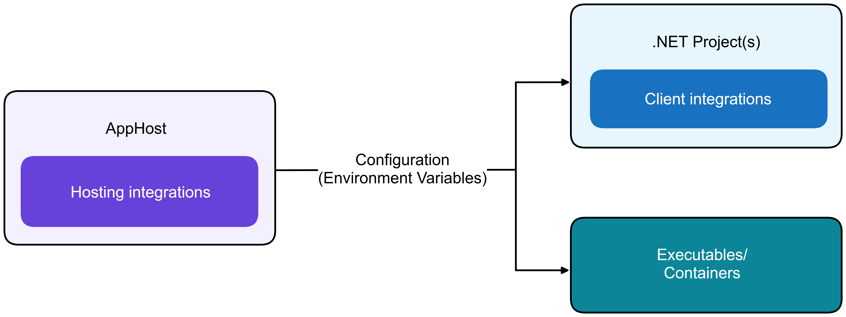
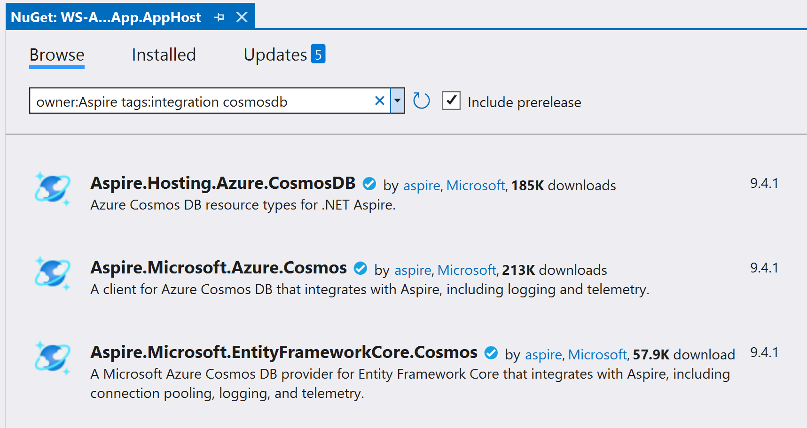

Slide 25
Integrations - Hosting
Running the resource
Projects
Running the container
Download the image
Create container
Configuring ports
…
Provisioning Azure resources

Slide 26
Integrations - Client
Responsible for
Configuring the dependency injection, based on environment variables
BlobServiceClient
EF.Core ‘DbContext’
RabbitMQ’s ‘IConnection’
…
Configuring possible health checks
DB connection can be established, and query can be executed
Configuring tracing

Slide 27
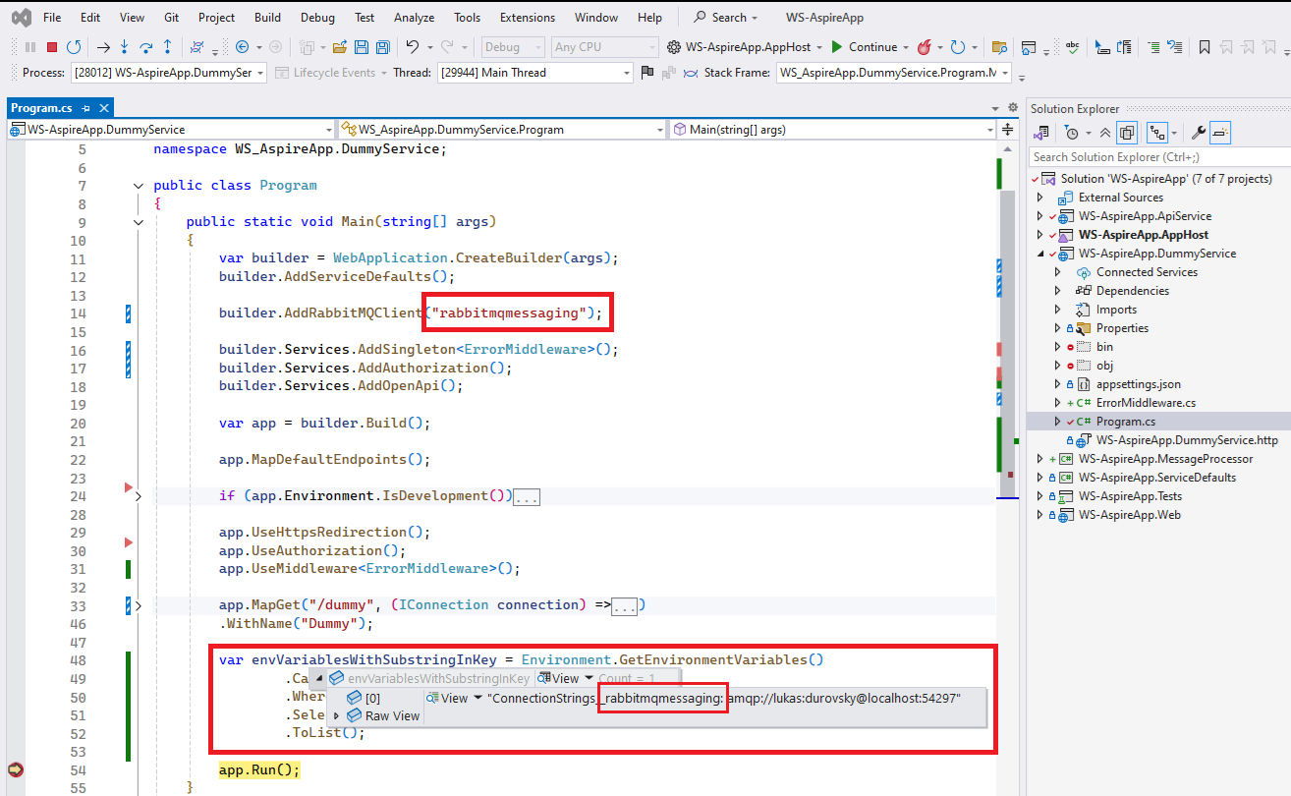
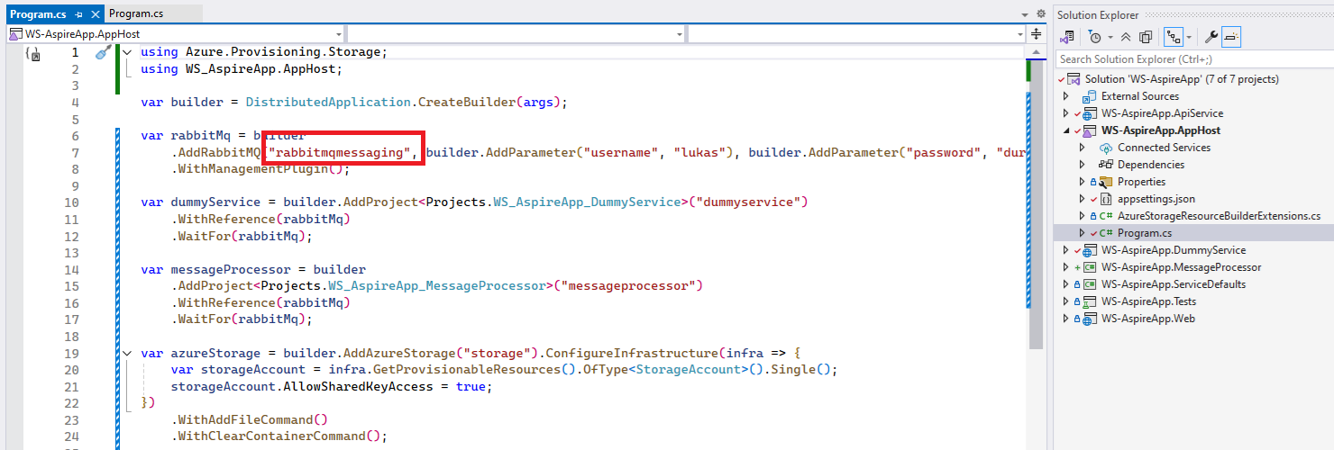

Slide 28
Dashboard

Slide 29
1. Resources
Resources, that your app is composed of
Projects, Containers, Executables, Azure Resources…
There are no connection-strings
Different kind of visualizations
Table
Graph

Slide 30
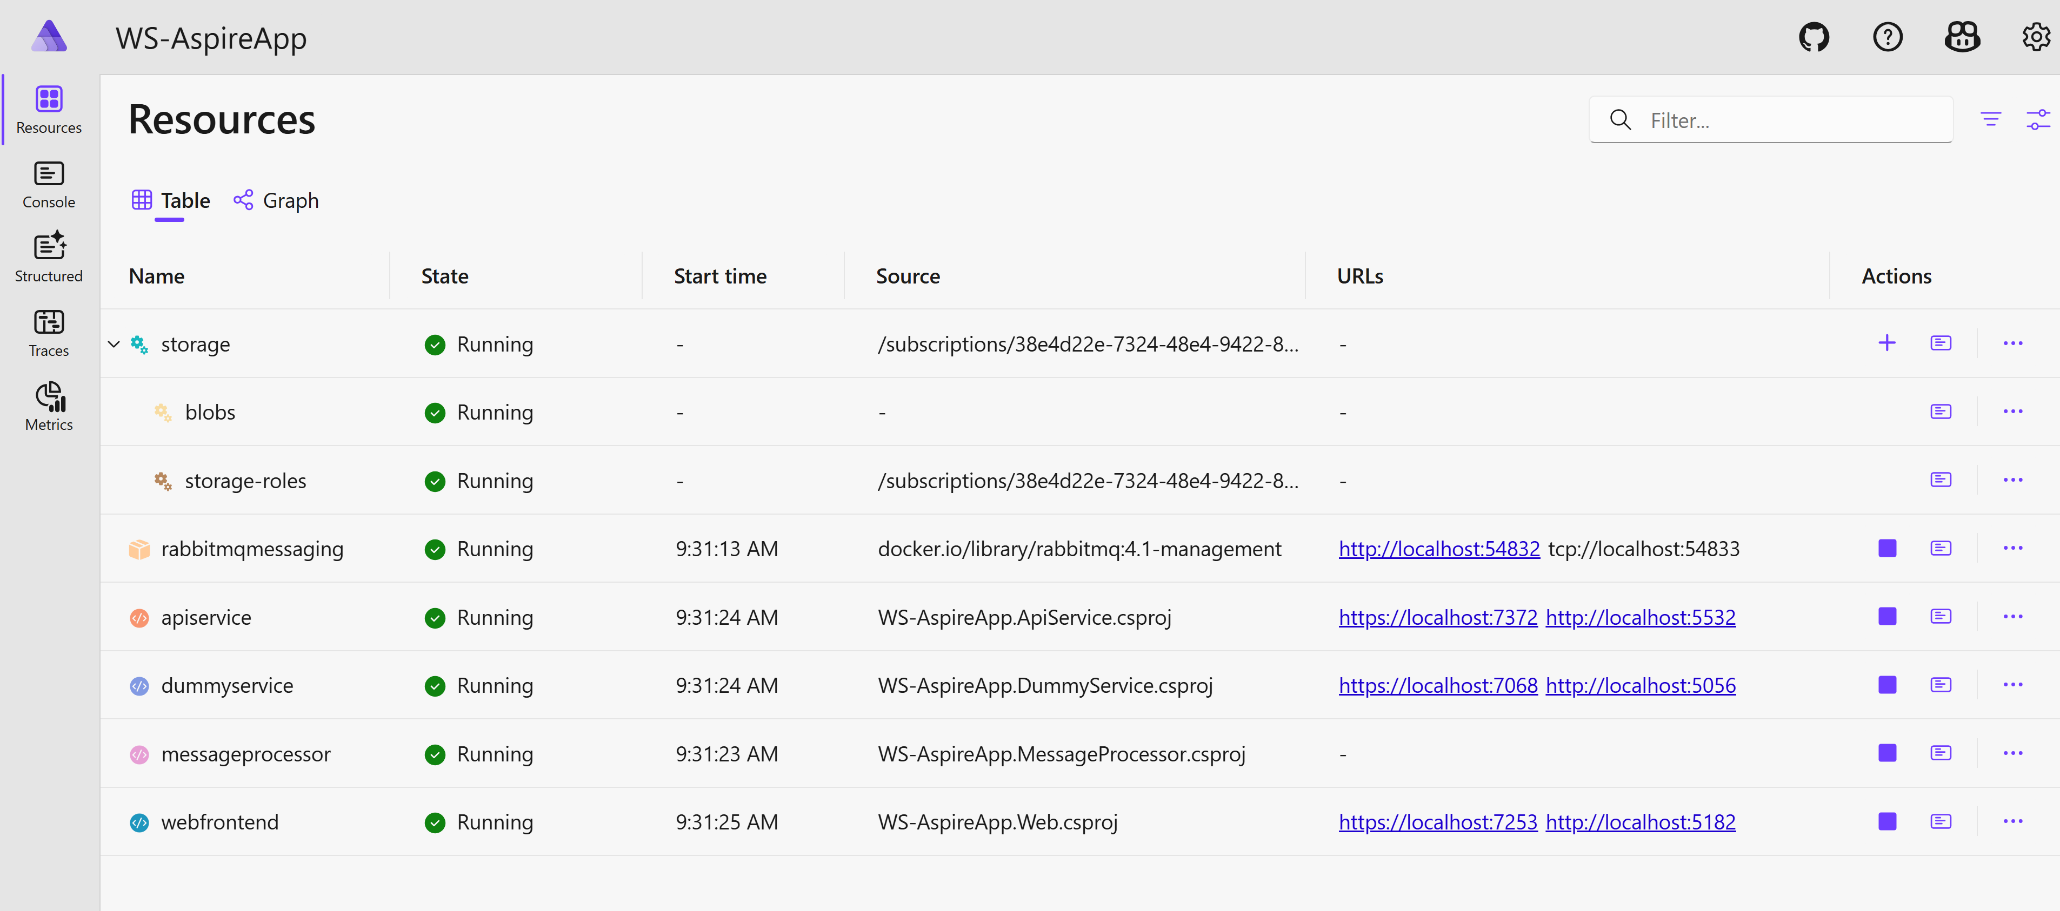

Slide 31
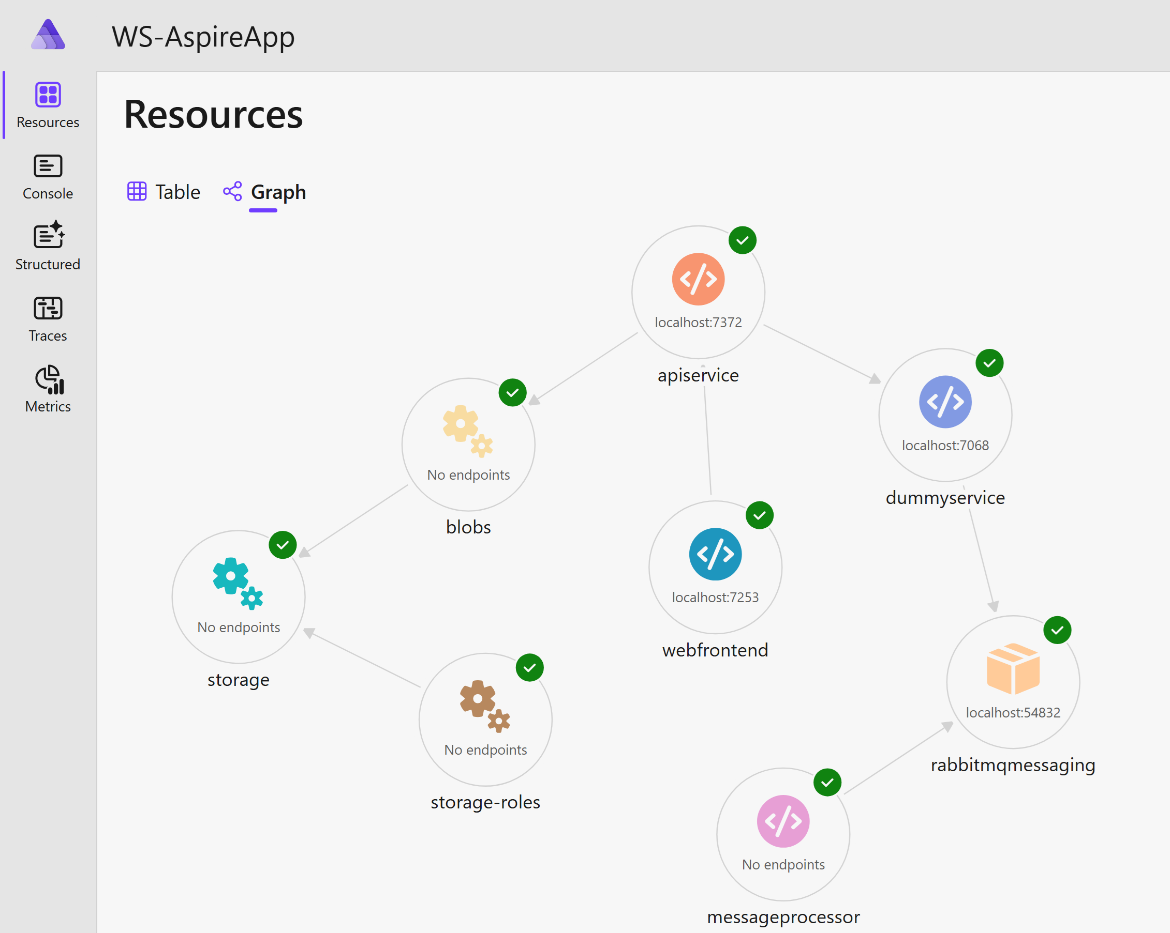

Slide 32
2. Custom commands
You can write your own commands for resource
Clearing data
Adding data
Executing scripts
…
.WithCommand<Tresource>(…)
.WithHttpCommand<Tresource>(…)
Logs from command-run are available in log of corresponding resource
⚠️ Commands are available just in development mode, not when deployed

Slide 33
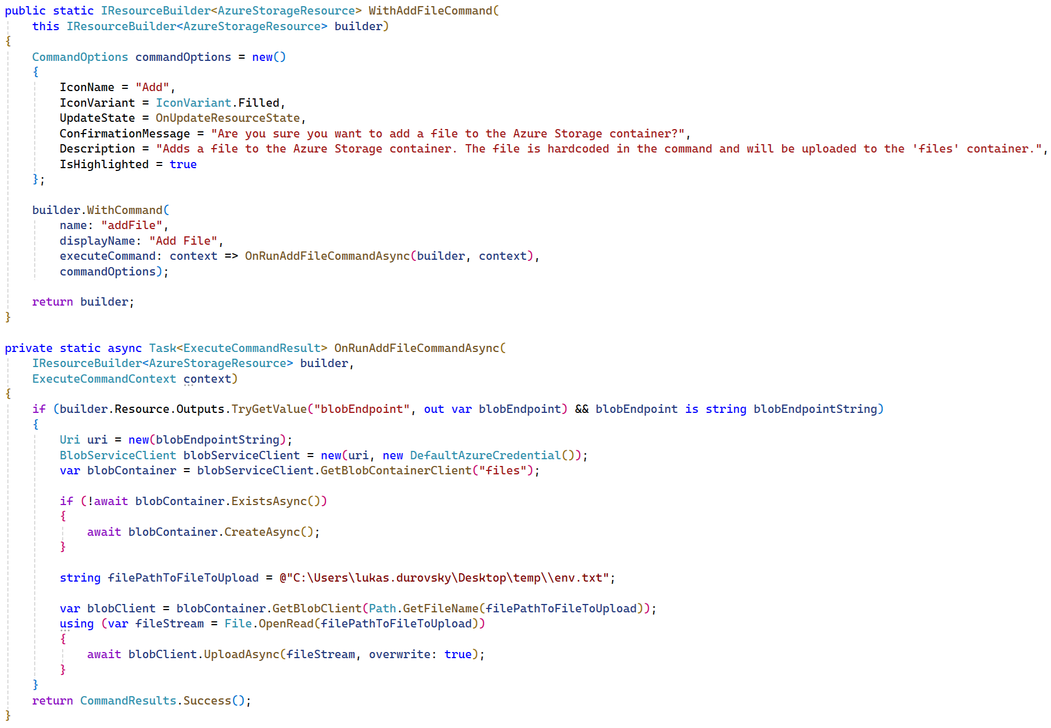

Slide 34
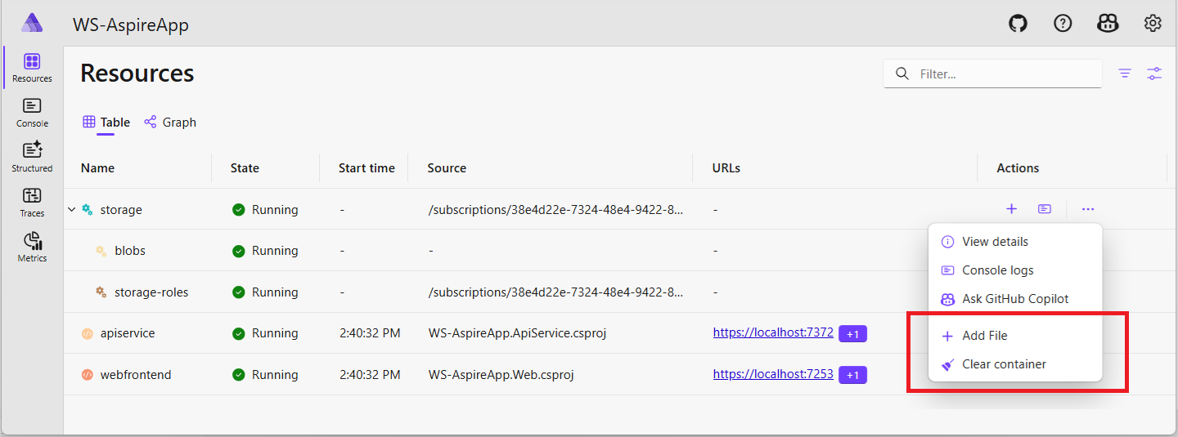

Slide 35
3. GitHub Copilot
You can use your AI-buddy even here ☺
Only available, when app run from IDE
GitHub account, valid Copilot subscription

Slide 36
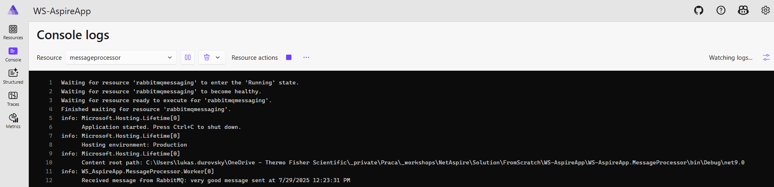
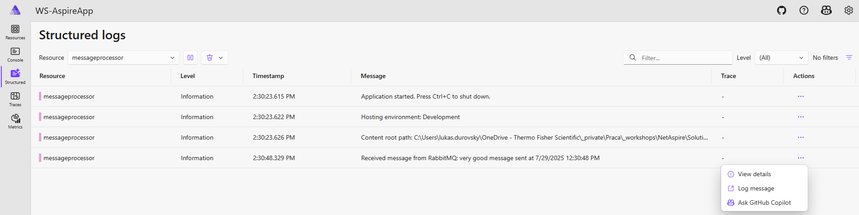
4. Console & Structured logs

Slide 37
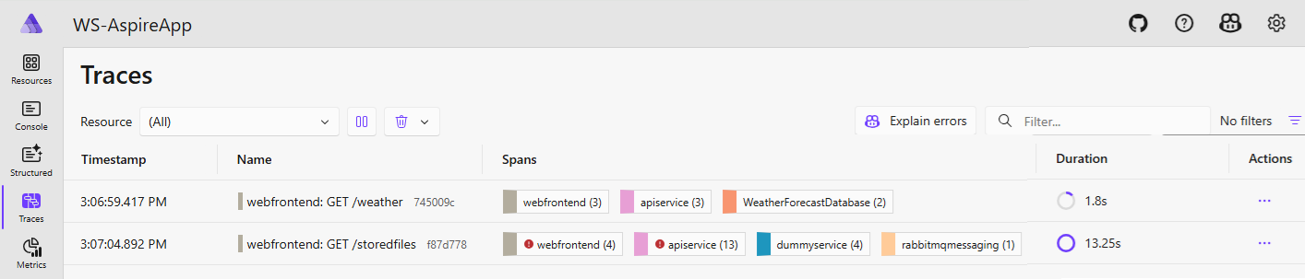
5. Traces
This is the consequence of ‘.AddServiceDefaults’ call in all appropriate places

Slide 38
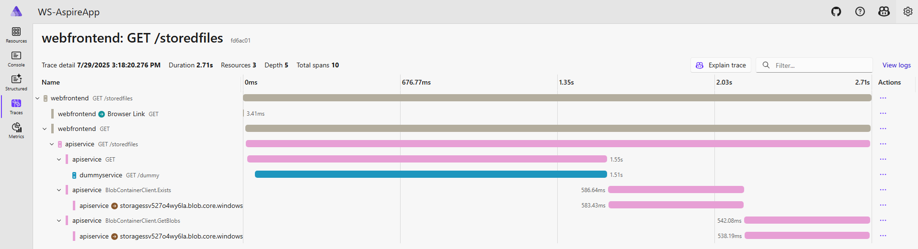

Slide 39
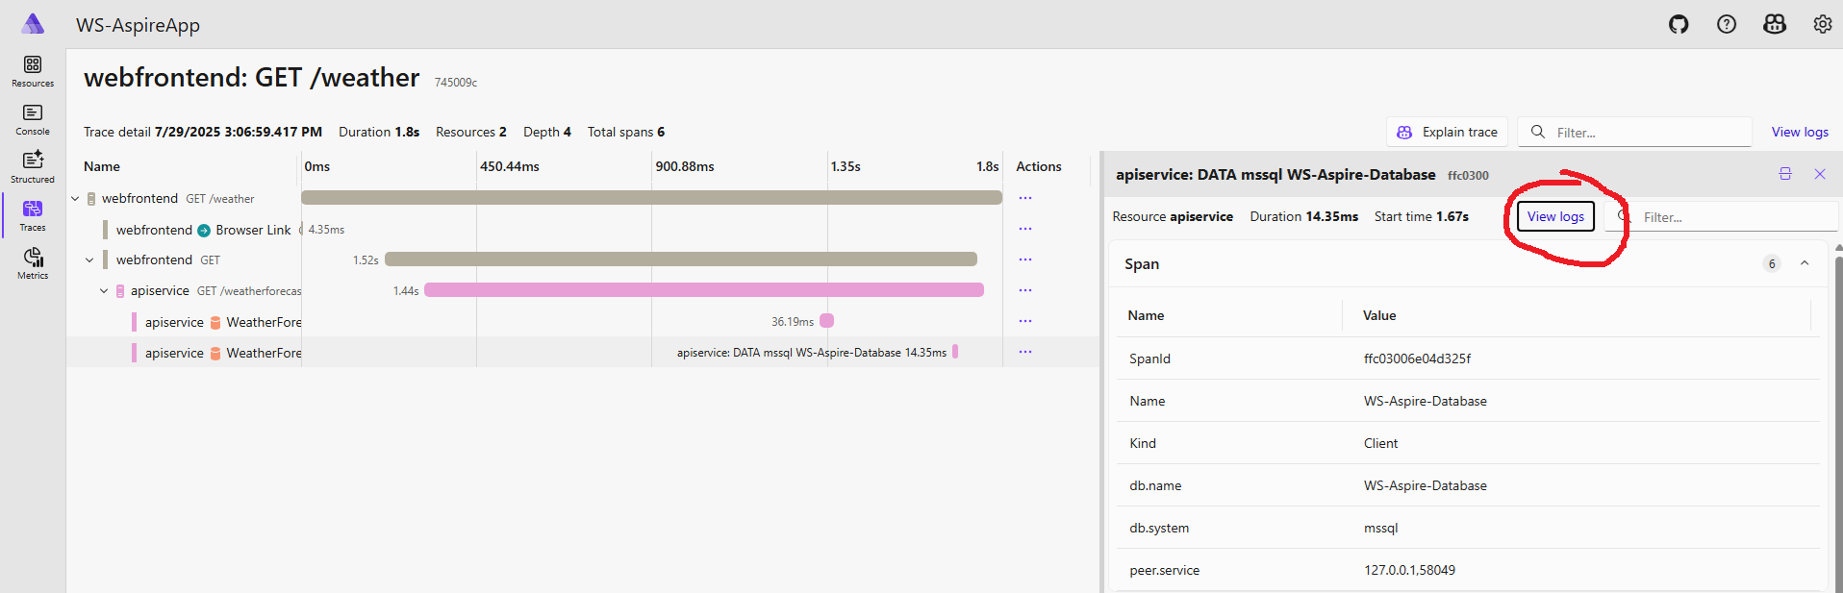
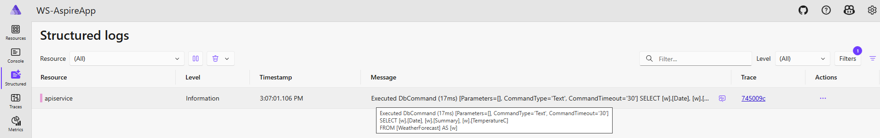

Slide 40
Deploying

Slide 41
AppHost project – modes
Run mode – local development, testing, debugging
Publish mode – deployment artifacts generation

Slide 42
Integrations – Hosting - Modes
Run mode – ‘builder.ExecutionContext.IsRunMode’
Publish mode – ‘builder.ExecutionContext.IsPublishMode’
Various extension methods
RunAsContainer (AzureSql, …)
RunAsEmulator (AzureStorage, …)
PublishAsConnectionString (RabbitMQ, …)
ExcludeFromManifest

Slide 43
More options
Visual Studio
Azure Developer CLI (azd)
Aspir8
Publish to Docker Compose

Slide 44
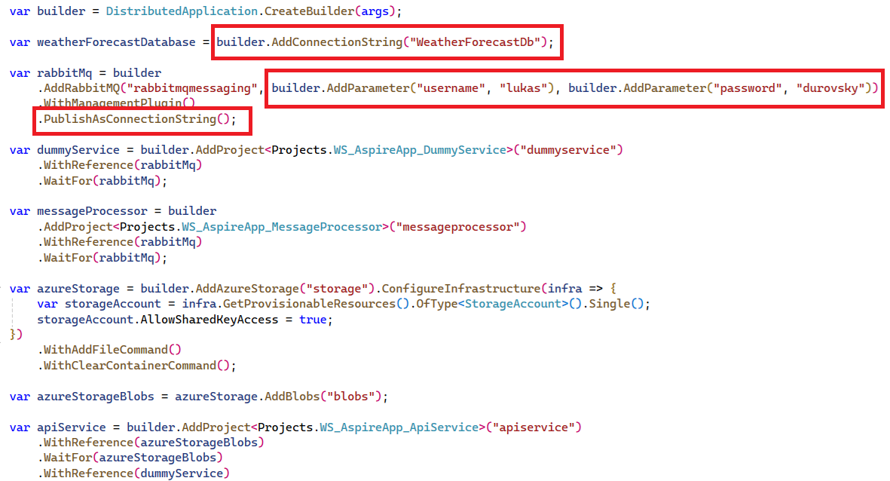

Slide 45
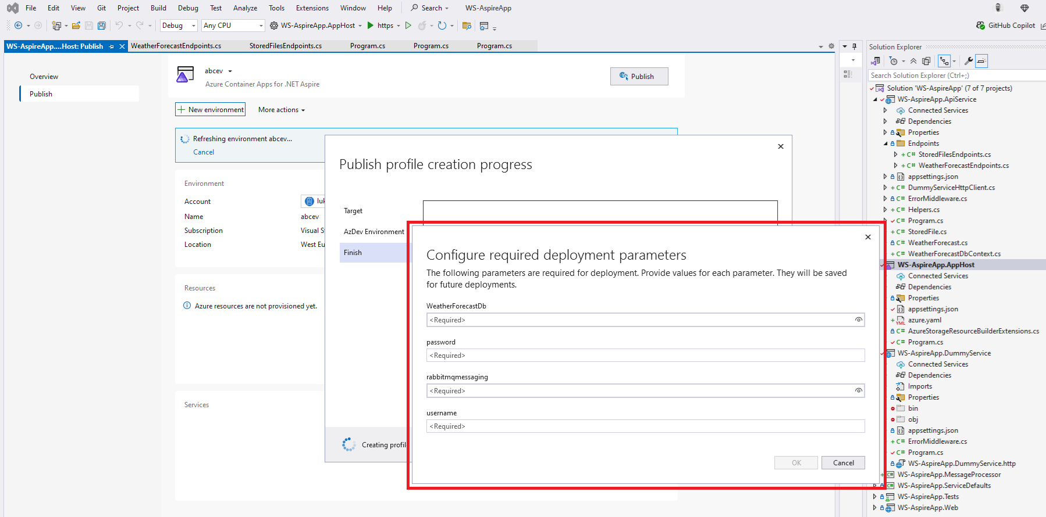

Slide 46
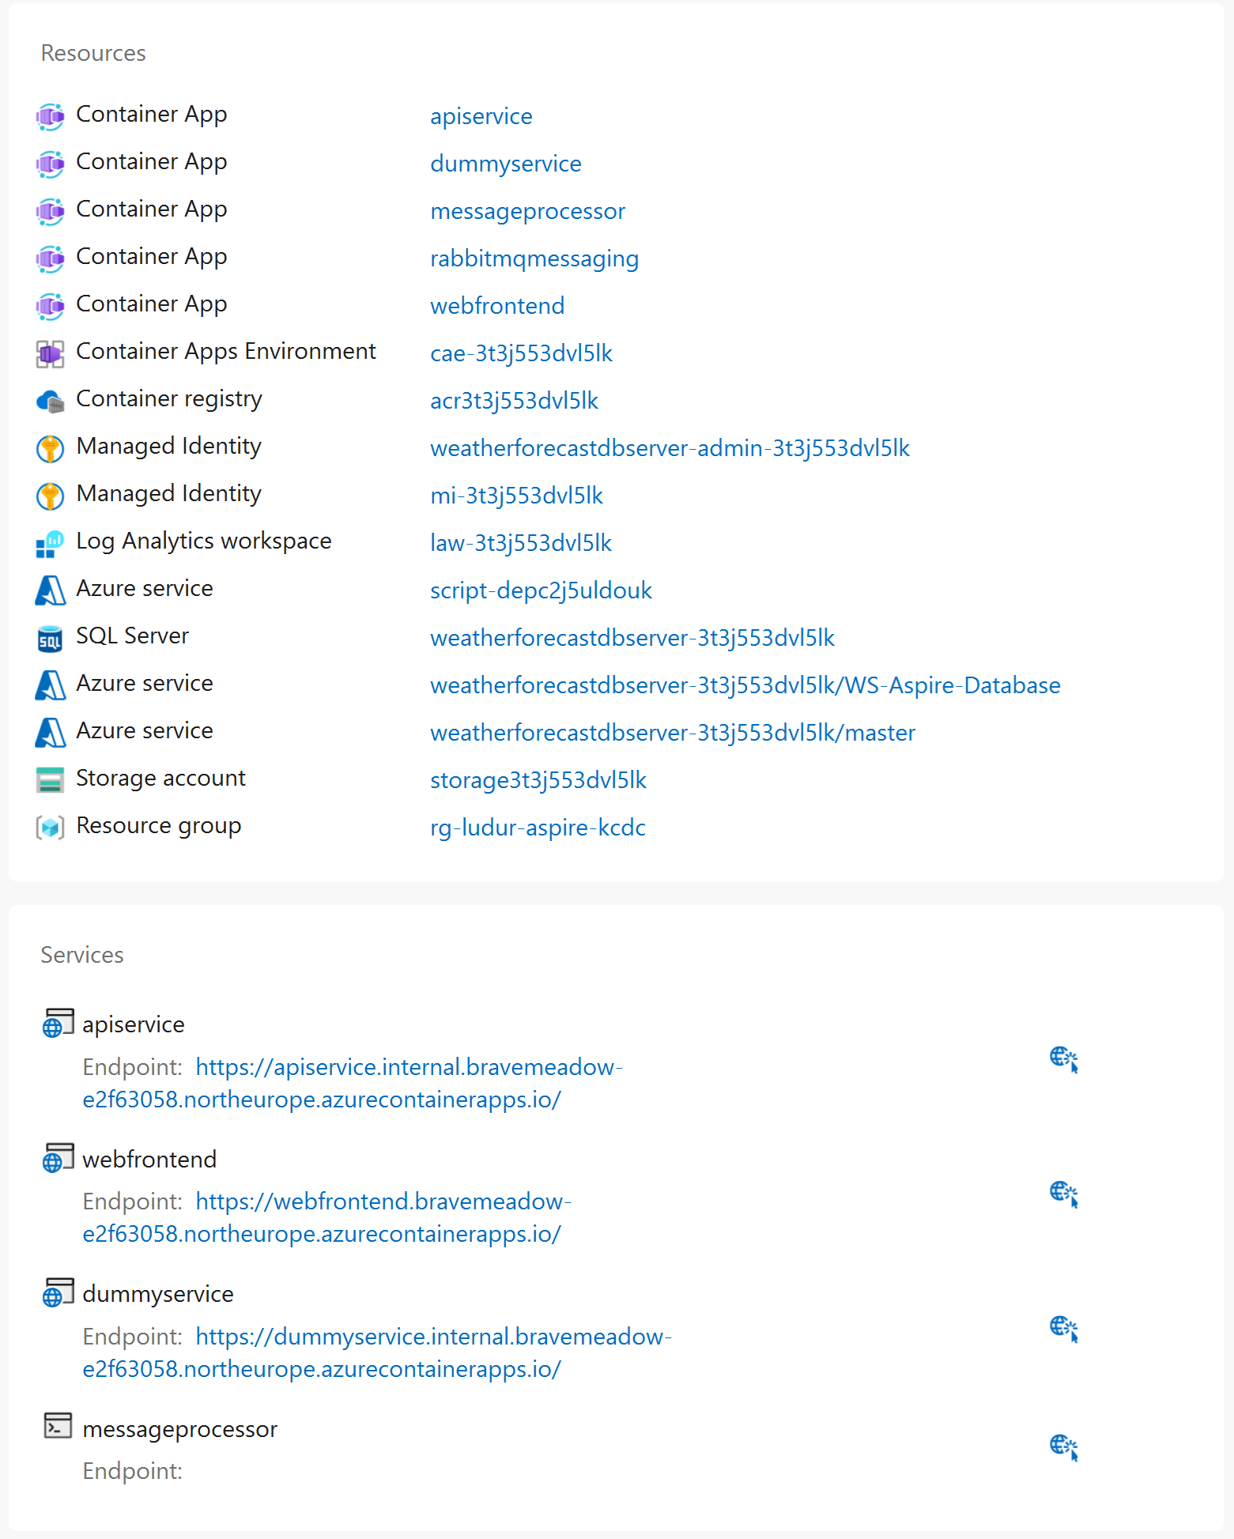

Slide 47
Testing

Slide 48
Testing
Test project can be added, when creating Aspire App, or later

Slide 49
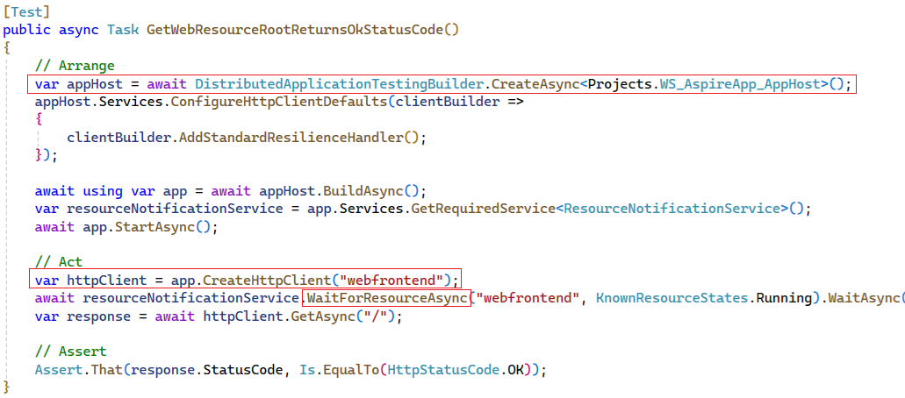
Testing
Usage of DistributedApplicationTestingBuilder

Slide 50
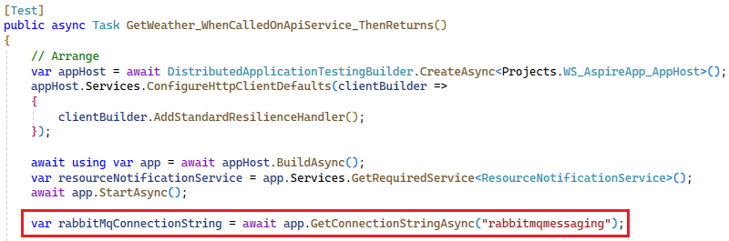
Testing
Get connection string to some resource
Naming – you must use same name as in AppHost/Program.cs file

Slide 51
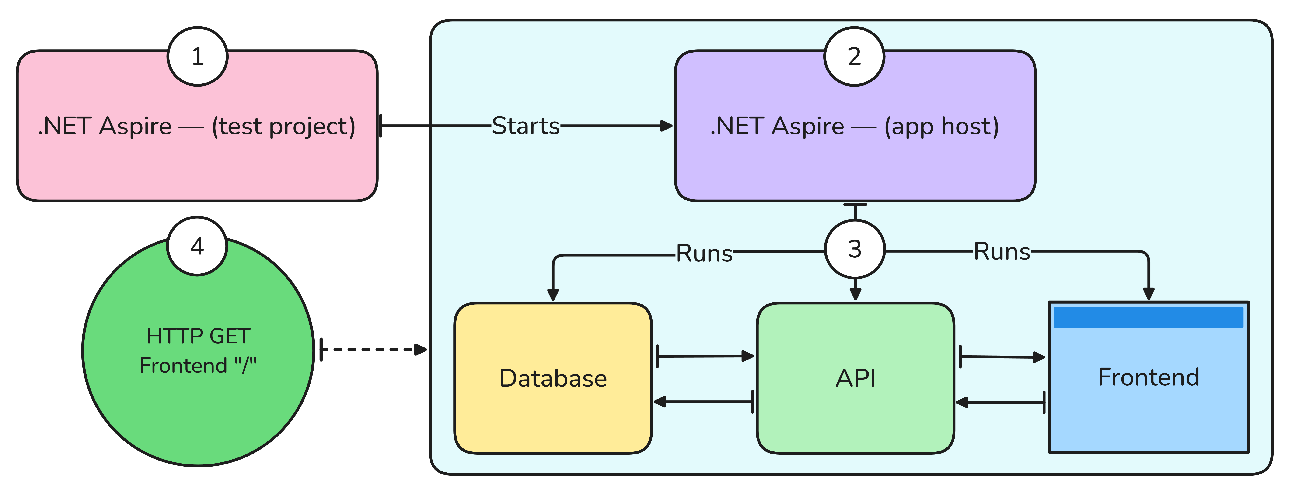
Testing
Whole app is started

Slide 52
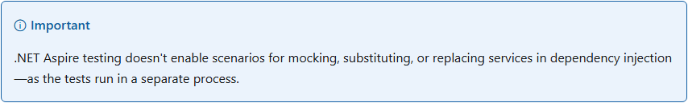
Testing

Slide 53
Testing
Be aware of quality of automated tests -> isolation, reproducibility

Slide 54
Thank you! Questions?
https://www.linkedin.com/in/ldurovsky/

Slide 55
Resources
https://learn.microsoft.com/en-us/dotnet/aspire/

